Slide 1
Reflective Dialogue in Professional Learning Communities
Colloquium Iris Héleen Meijlof
Master EST
(External) Supervisors:
Dr. Cindy Poortman, Dr. Kim Schildkamp & Wenckje Jongstra (KPZ)
Octobre 18, 2018

Slide 2
Table of Content
Introduction
Problem Definition
Theoretical Framework
Method
Results
  Case #1
  Case #2
  Case #3
  Case #4
Summary
Conclusion/Discussion

Slide 3
1. Introduction
Teacher participation in Professional Learning Communities (PLC’s) is considered a promising way of professional development that also supports student improvement (Stoll, Bolam, McMahon, Wallace & Thomas, 2006; Vescio, Ross & Adams, 2008; Prenger, Poortman & Handelzalts, 2017).
Reflective Dialogue is one of the essential aspects of effective PLC’s (Poortman & Brown, 2018)
Thesis in the context of the Katholieke Pabo Zwolle (KPZ)
Notes:
PLC: are teams of teacher and/or school leaders working together to improve student learning.
Context of KPZ: PLC’s within schools that are led by a teacher leader who are educated in the Master Program Learning and Innovation

Slide 4
2. Problem Definition
Literature shows mixed effects of PLC’s (Hord, 2004; Stoll et al., 2006; Blankenship & Ruona, 2007; Spanneut, 2010; Bruns & Bruggink, 2015; Prenger et al., 2017).
KPZ questionnaire adds to the mixed effects seen in literature
Depth in a PLC meeting
Notes:
literature suggests the challenge to find depth in a PLC meeting: i.e. to – reflect on the current way of working, reason why something needs to be done differently and for example use data and literature to improve student learning

Slide 5
3. Theoretical Framework
Within-School Professional Learning Communities (PLC’s)
A group of teachers within schools that come together to share knowledge and experiences across different but relevant areas of education in a structured manner whereby the insights gained becomes practically applied in order to improve student performance
Reflective Dialogue
A conversation wherein two or more colleagues reflect with each other and in which they deeply engage based on experience, data and/or literature

Slide 6
Reflective Dialogue
Experience
An experience with an occurring situation (Korthagen & Vasalos, 2005)
Any experience gained or available to the teacher about something (e.g. a particular subject)
Data
Information that is systematically collected and organized to represent some aspect of schools (Schildkamp, Poortman & Handelzalts, 2016)
Literature
Reading and discussing different types of literature to gain knowledge about a particular subject. Actively processed = more likely to be learned and transferred to practice
Notes:
Experience is considered to be the biggest source on which reflection is initialized (Korthagen & Vasalos, 2005). An experience within a concrete situation often is the starting point from which people reflect. This experience might entail an event that occurred during practice and which is still lingering in the teachers’ mind (e.g. a teacher notices that there are still a number of children who seem to have difficulties with some aspect of investigative learning). From Schildkamp et al. (2016) it is apparent that teachers need to combine experience with evidence. Decisions solely based on experience or intuition are not always made well. Here data and literature can be used to inform a decision based on evidence and this can support teacher improvement in order to improve student performance (Schildkamp et al., 2016; Brown et al., 2017; Brown, 2017).
Data and Literature can be used for evidence-informed decisions. Based on evidence provided by data and/or litereature well informed decisions can be made with a more sustainable character.

Slide 7
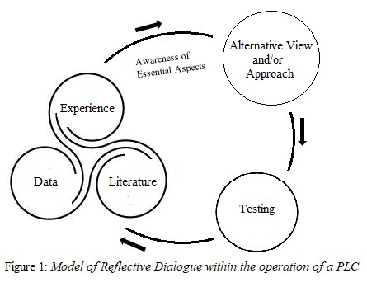
Model of Reflective Dialogue

Slide 8
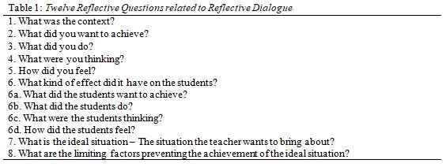
Structure of Reflective Dialogue
Reflective Questions

Slide 9
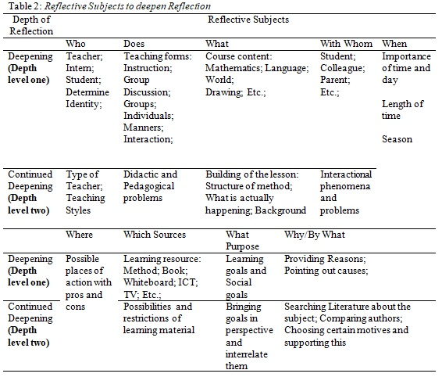
Structure of Reflective Dialogue
Reflective Subjects
Notes:
Reflective Subjects provide “subjects” to reflect upon. They can be used to initialize reflection. For example reflecting upon an interactional phenomena between teacher and student(s). This offers depth levels of reflection. The most important difference is that the deeper the level of reflection reasons, pointing out causes, searching literature about the subject and then choosing certain motives and supporting this become more related to it.

Slide 10
Master Learning and Innovation
Teacher Leaders
CPO (Collective Practice Research)
PRO (Professional Reflection Assignment)
CPO → Three phases
Diagnosis – a problem is analysed and literature is searched and used to establish a framework regarding the subject of the CPO
Design – Working out the framework into an intervention
Evaluation – the implemented intervention is evaluated in its effectiveness by using data and literature

Slide 11
Research Question(s)
How do PLC’s engage in Reflective Dialogue
  What is the role of experience/data/literature in PLC meetings?
  In which way are the elements of Reflective Questions present in PLC meetings?
  In which way are the elements of Reflective Subjects present in PLC meetings?

Slide 12
Method
Quantitative Questionnaire (Hipp & Huffman, 2010) to select four PLC’s
Instrumentation:
  Interview
  Document Analysis of CPO and PRO
  Codescheme to analyse interview
Respondents:
  4 MLI students documents CPO and PRO
  7 (Duo interview MLI student and Colleague)
  Substantial Interrater Reliability of κ = 0.781 (Sim & Wright, 2005)
Notes:
Sub scales related to reflective dialogue of QQ from KPZ used to select the four highest scoring PLC’s (on a scale of 0 – 100). Eventually two PLC’s with the highest scores participated in the research due to circumstances.
Interview and documents were analysed based on the theoretical framework (code scheme). Which aspects of RD can be found in the interviews and docuemnets. By analysing the interview and the documents the intention was to triangulate the results in order to provide a more complete picture per case

Slide 13
Results:
Case #1 Self-Direction
Number of PLC-members: 5
Goal: Develop an instrument for self-directed learning for the students AND
to increase the knowledge base and the shared vision of the school
Facilitated: YES
Effectiveness: POSITIVE
Notes:
Effectiveness: After the design it seems that the teachers are able to guide the students in the steps of looking forward, keeping track and looking back. Although, a difference is noticed to the extent to which individual students are able to apply the design.

Slide 14
Case #1
The Role of Experience, Data and Literature
 | Diagnosis | Design | Evaluation
Experience | Experience of the teachers to determine the problem regarding self-direction in students AND the collective learning of the team | The pre-existing knowledge and/or gained experience of the teacher regarding education and/or the subject was found as being input in the PLC meetings in designing an approach of the intervention. | Experience of the teachers regarding the execution of the design AND the pre-existing/gained experience regarding education/the subject of the intervention to be able to analyse the data results
Data | Systematically gathered data e.g. interviews, personality questionnaires, questionnaires with teachers and students, and a collective learning questionnaire | Systematically gathered data e.g. logbooks, conversations with teachers and students as input in the conversation. The findings hereof were dicussed with the PLC in the meantime. They were able to respond to findings when designing the intervention. | Systematically gathered data e.g. logbooks, conversations with teachers and students, questionnaire into teacher and student behavior
Literature | Scientific literature used to gain knowledge about the subject of self-direction. This knowledge is shared between the members in a PLC meeting | Scientific literature and books were used to gain knowlege about the subject and to provide the PLC with for example various questions they could ask regarding self-direction. It also provided them with a structure to base the design criteria of the intervention upon. | No evidence was found for literature to be used during this phase by and in the PLC.

Slide 15
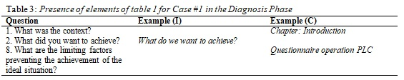
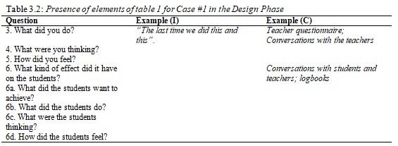
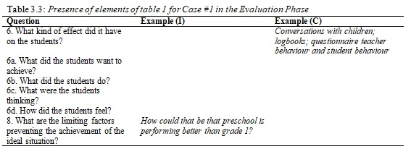
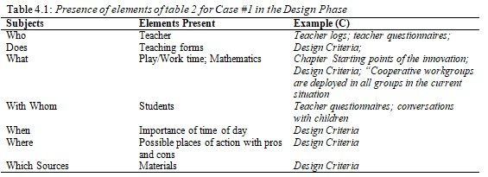
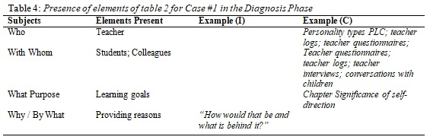

Case #1 The elements of Reflective Questions and Subjects (1)

Slide 16
Case # 1
The elements of Reflective Questions and Subjects
Phase | Use of Reflective Questions | Use of Reflective Subjects
Diagnosis | Reflectively used | Reflectively used
Design | Practically and Reflectively used | Practically and Reflectively used
Evaluation | Practically and Reflectively used | Practically and Reflectively used

Slide 17
Results:
Case # 2 Pre-teaching in Mathematics
Number of PLC-members: 5
Goal: Determine the effect of pre-teaching of self-esteem, pleasure and engagement of the students for mathematics
Facilitated: YES
Effectiveness: POSITIVE
Notes:
Effectiveness: The evaluation results (based on the gathered data such as: logbooks, questionnaires, flash visits and student focus group) showed that the teachers and students were satisfied about the deployment of pre-teaching during mathematics and that it presumably contributed to the pleasure, self-esteem and engagement during the mathematic lessons according to the CPO.

Slide 18
Case #2
The role of Experience, Data and Literature
 | Diagnosis | Design | Evaluation
Experience | Experience of the teachers regarding the mathematic lesson. Used to determine the subject of the intervention. | Experience with an instructional element to work well or not. Experience with the execution of the design. | The experience of the teacher during the execution of the pre-teaching was recorded. Used as input while gathering data. And experience with pre-teaching and the knowledge they gained about the subject during the diagnosis phase. This was used to interpret the results and give meaning to it.
Data | Systematically gathered data e.g. video footage – observe how differentiation was currently applied, “silent dialogue” – deployed to gain insight in the needs of the teachers in order to differentiate | Systematically gathered data to be eventually used in the evaluation phase | Systematically gathered data e.g. logbooks, flash visits, student questionnaire, conversations with teachers and students. Used to establish the effect of the intervention on the pleasure, self-esteem and engagement in students.
Literature | Scientific literature used to gain knowledge about the subject of mathematics e.g. what should differentiated instruction look like, which knowledge and skills teachers need. | Scientific literature used to design the differentiated mathematic lesson. | No evidence was found for literature to be used in the evaluation phase. The role of literature seemed to diminish during the entire process (e.g.: “Literature has actually been our starting point in devising this. After that literature was used, but not much new literature. In the beginning it was more based on literature and then more and more on experience”.

Slide 19
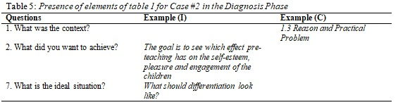
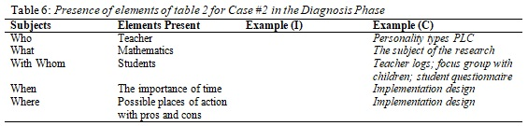
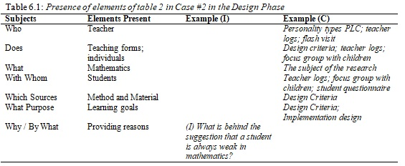
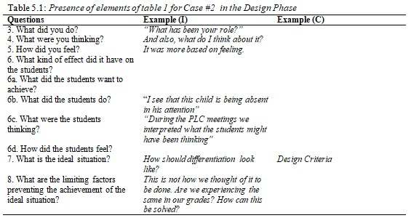
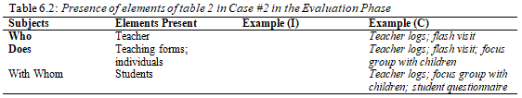
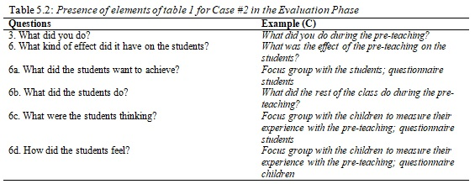
Case #2
The elements of Reflective Questions and Subjects (1)

Slide 20
Case #2
The elements of Reflective Questions and Subjects (2)
Phase | Use of Reflective Questions | Use of Reflective Subjects
Diagnosis | Reflectively used | Practically and Reflectively used
Design | Reflectively used. | Practically and Reflectively used
Evaluation | Practically and Reflectively used | Practically and Reflectively used

Slide 21
Results:
Case # 3 Success criteria
Number of PLC-members: 5
Goal: to implement a feedback system in the lower grades based on success criteria in mathematic learning goals. And the collective learning from the members of the PLC.
Facilitated: NO
Effectiveness: POSITIVE
Notes:
Effectiveness: The effect of the intervention designed by the PLC derived from the CPO was that it seemed that on many points individual growth was seen in applying the success criteria and feedback. The students seemed to be more involved when the teachers spend time on the success criteria by providing them with feedback. Considering collective learning, the teachers in the PLC seemed to have increased in their level of collective learning

Slide 22
Case #3
The role of Experience, Data and Literature
 | Diagnosis | Design | Evaluation
Experience | Experience of the teachers with feedback and success criteria to determine what the PLC wants to accomplish | Experience with the success criteria was input for the conversation wherein knowledge about this subject was being shared with the other PLC members. This experience contributed as support for designing the intervention. Experience with the execution of the design | Experience of the data with the execution of the design. Input into the systematically gathered data for evaluation.
Data | Systematically gathered data e.g. “silent dialogue”, questionnaire operation PLC, interviews and the colour test of De Caluwé (2003). Data was gathered to determine which factors might influence the entire process of the intervention. Data used to establish a starting situation e.g. teacher questionnaire and observation. | Systematically gathering the data for the evaluation phase. No evidence found for input into the conversations in the PLC meetings. | Data used to measure the effectiveness of the intervention and to establish points of improvement e.g. logbook, questionnaire start and end-measurement, a storyline, and questionnaire of collective learning.
Literature | Scientific literature used to gain knowledge about the subject of feedback and success criteria. | Scientific literature read and used together in the PLC regarding the subject of feedback and success criteria. Provided the PLC with support how to implement the information in the design of their intervention. | No evidence was found for literature to be used during the phase of evaluation

Slide 23
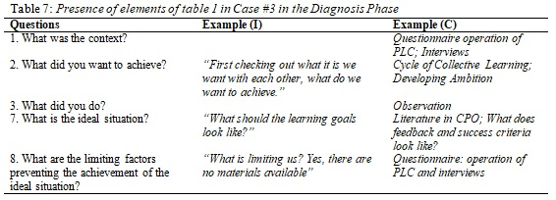
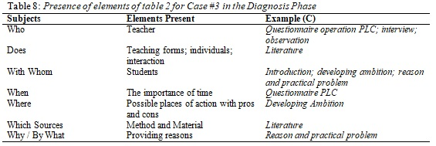
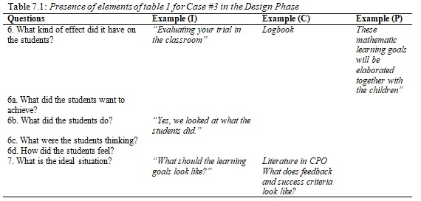
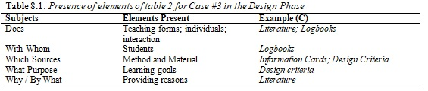
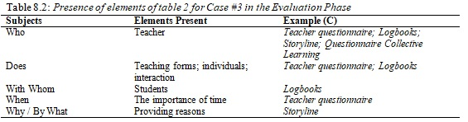
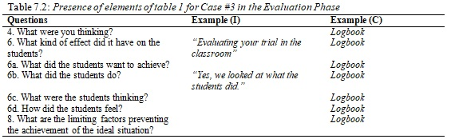
Case #3
The elements of Reflective Questions and Subjects (1)

Slide 24
Case #3
The elements of Reflective Questions and Subjects (2)
Phase | Use of Reflective Questions | Use of Reflective Subjects
Diagnosis | Practically and Reflectively used | Practically and Reflectively used
Design | Practically and Reflectively used | Practically and Reflectively used
Evaluation | Practically and Reflectively used | Practically and Reflectively used

Slide 25
Results:
Case # 4 World Orientation (WO)
Number of PLC-members: 6
Goal: to implement a feedback system in the lower grades based on success criteria in mathematic learning goals. And the collective learning from the members of the PLC.
Facilitated: YES
Effectiveness: not yet reached the evaluation phase
Notes:
Two different PLCs used in this case. Interview based on WO. CPO based on higher order thinkgins skills in WO.

Slide 26
Case #4
The role of Experience, Data and Literature
 | Diagnosis | Design | Evaluation
Experience | Experience of the teachers with the core concepts of the current WO lessons. It did not seem substantial. No particular learning goals causing the activities to be less meaningful. | Experience of the teachers in practice and the experience of the teachers with regard to a particular subject. | Experience of the teachers in practice for example an experience they had while teaching the students e.g. “I could not follow the student at all, because the groups were too big, how can it be done differently?”.
Data | No data was used during the entire process of this PLC. The members state: “We are not yet there that we need it. But when we do, we will think about it”.
Literature | Scientific literature and books used to gain knowledge about the subject of WO. Used to orient themsleves in the field of WO in education before handling the core concepts. | Scientific literature and books were sometimes read individually and sometimes together. What was read was shared with the PLC by for example presenting what was learned to the other PLC-members. Literature was also used to explain an occurring situation or to provide the PLC with support for an alternative approach | Scientific literature and books were sometimes used to reason why particular things occurred during the lessons.
Notes:
NOTE: PLC has not reached evaluation phase yet. Evaluation here relates to “mini” evaluation during the execution of the design especially between two members of the PLC

Slide 27
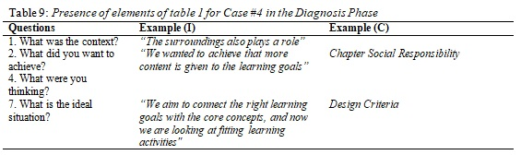
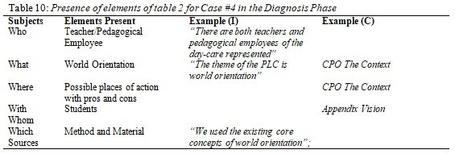
Case #4
The elements of Reflective Questions and Subjects (1)

Slide 28
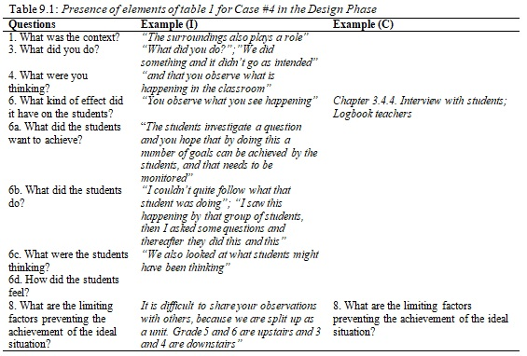
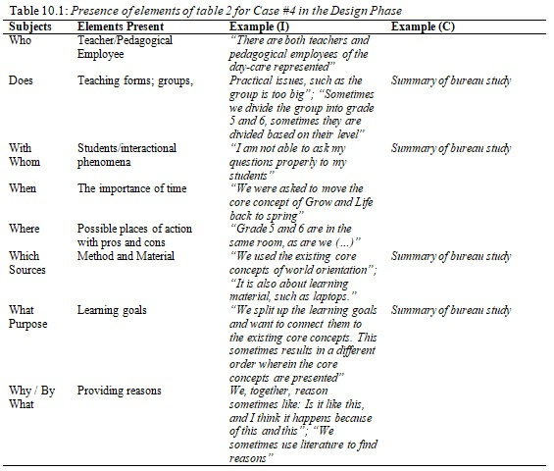
Case #4
The elements of Reflective Questions and Subjects (1.1)

Slide 29
Case #4
The elements of Reflective Questions and Subjects (2)
Phase | Use of Reflective Questions | Use of Reflective Subjects
Diagnosis | Practically and Reflectively used | Practically used
Design | Reflectively used | Practically and Reflectively used

Slide 30
Summary
Experience, data and literature played a role during the phase of diagnosis and design.
Experience and data played a role during the phase of diagnosis, design and evaluation.
When present, experience, data and literature were almost always combined.
Reflective Questions and Subjects sometimes practically used when it related to the application in practice but almost always also with the intent to clarify practice, explain underlying views, share knowledge and to solve problems.
Notes:
3. As experience formed input several times for data whereas literature always was input in the PLC for gaining knowledge contributing to the experience of the teachers and providing them with evidence based frameworks to design the intervention upon.

Slide 31
Conclusion & Discussion
How do PLC’s engage in Reflective
Dialogue in PLC meetings?
The PLC’s engaged in a conversation based on experience, literature and self-collected data. There was much evidence for reflective dialogue as in many cases reflective questions and subjects appeared to be used as intended overall in the entire process of the PLC’s. However, they were used in different ways during the diagnosis, design and evaluation phase. During the phases different reflective questions and subjects appeared to be used. As such, every phase was distinguished by its own appearance of particular reflective questions and subjects. When there was an overlap of reflective questions and subjects in the phases it appeared that the reflective questions or subjects served a different purpose/angle in every phase.
In some cases the reflective questions and subjects were mostly used between members of the PLC and not per se during the PLC meetings, for example discussing a lesson in the classroom, hallway or schoolyard with another PLC member outside of the PLC meetings. Therefore, it needs to be considered that the conversations not only took place in the PLC meeting. In addition to that, sometimes these conversations were transferred to the PLC meeting. And forms input into the conversations of the PLC. As such, the “duo” conversation became a shared conversation in the PLC where it became owned by the PLC.

